Slide 1
DataBase
Final Assignment

Slide 2
Scenario
George wants to design a high-speed rail booking system. this system is very special. It only has five stations (Taipei, Taoyuan, Hsinchu, Taichung, Kaohsiung),and there are only six trains a day. Each train has only two cars with a total of 40 seats,and the daily shift is the same. George is in need of everybody’s help. He only knows what the needs are and looks forward to making a George's ideal booking system.
The description of the system is as follows:
User login is required to use the system. After login page, George would like to divide the system into “booking step” and “paying step”. A ticket contains the information of 1.) ticket id 2.) train id 3.) departure station and arrival station 4.)departure and arrival time 5.) price. 6.) user id 7.) seat id

Slide 3
Scenario
The booking process is as below:
Input the departure station, arrival station and departure time.
The system will display the train id, departure station arrival station,departure time arrival time and price.
Users can then choose the train id he/she would like to take.
Then the booking process is all done. However, there are some limitation when booking tickets:
The users can only book the tickets within 14 days.
It is not allowed to book the tickets within 30 minutes of departure.
Once a user booked a ticket, he/she can only delete it. Reschedule a ticket is not allowed.

Slide 4
Scenario
On the paying side. User must pay in 3 days after booking and 30 minutes before departure. After the payment is confirmed, the paying process has been done. If something came up resulting a user not being able to take the original train, he/she can only cancel the ticket 30 minutes earlier than the departure.It should be noted that if the ticket has been paid, it cannot be cancelled (No refund)

Slide 5
高鐵時刻表-南下
車次 | 台北 |  | 桃園 |  | 新竹 |  | 台中 |  | 高雄
 | arr | dep | arr | dep | arr | dep | arr | dep | arr | dep
1 |  | 7:00 | 7:20 | 7:22 | 7:32 | 7:34 | 8:04 | 8:06 | 9:06
2 |  | 10:00 | 10:20 | 10:22 | 10:32 | 10:34 | 11:04
3 |  | 13:00 | 13:20 | 13:22 | 13:32 | 13:34 | 14:04 | 14:06 | 15:06

Slide 6
高鐵時刻表-北上
車次 | 高雄 |  | 台中 |  | 新竹 |  | 桃園 |  | 台北
 | arr | dep | arr | dep | arr | dep | arr | dep | arr | dep
4 |  | 8:00 | 9:00 | 9:02 | 9:32 | 9:34 | 9:44 | 9:46 | 10:06
5 |  |  |  | 12:00 | 12:30 | 12:32 | 12:42 | 12:44 | 13:04
6 |  | 17:00 | 18:00 | 18:02 | 18:32 | 18:34 | 18:44 | 18:46 | 19:06

Slide 7
座位表
1 車廂
2 車廂
1A | 2A | 3A | 4A | 5A
1B | 2B | 3B | 4B | 5B
6A | 7A | 8A | 9A | 10A
6B | 7B | 8B | 9B | 10B
1C | 2C | 3C | 4C | 5C
1D | 2D | 3D | 4D | 5D
6C | 7C | 8C | 9C | 10C
6D | 7D | 8D | 9D | 10D

Slide 8
Entities
User
User Credential
Train
Seat
Station
Ticket

Slide 9
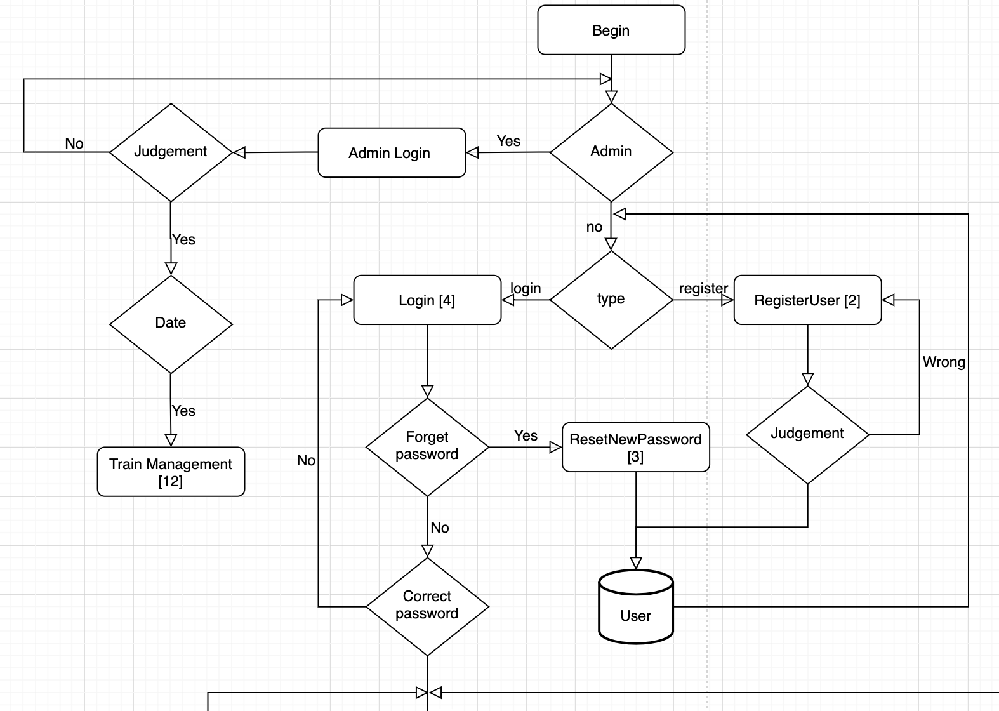

Slide 10
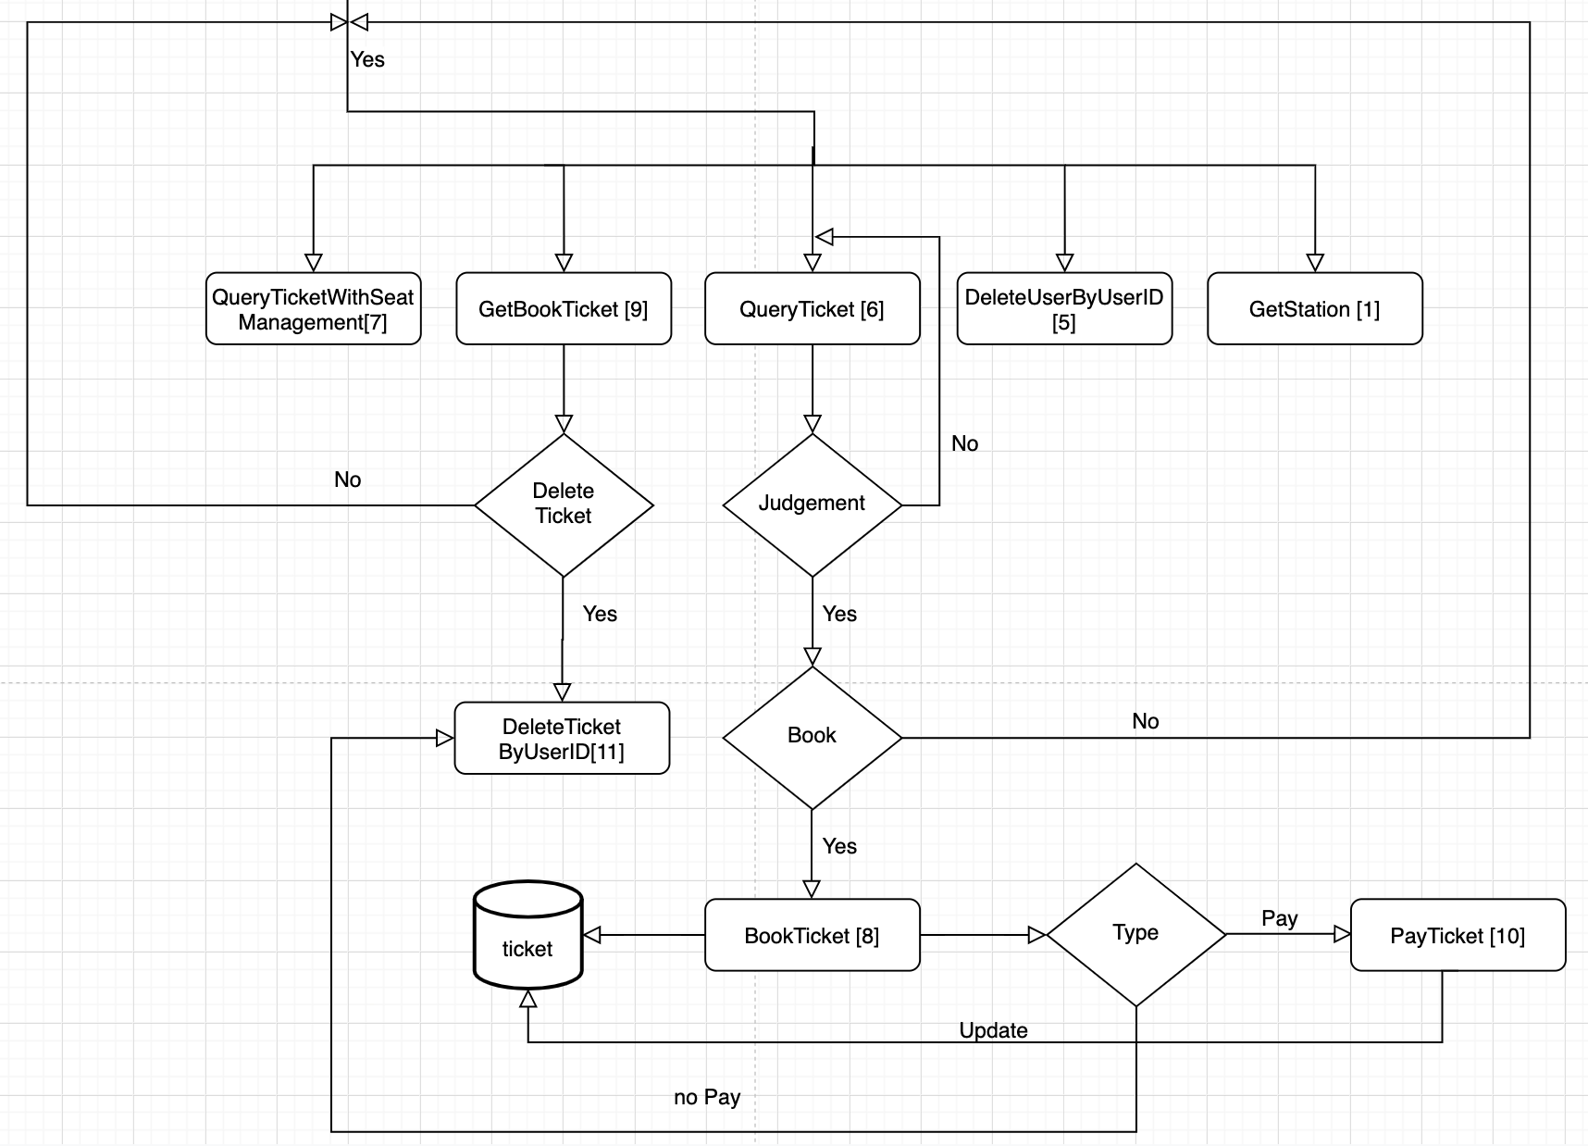

Slide 11
Business Logics/Rules about User
A user is associated with one account.
User contains the information of 1.) User_id(PK) 2.) Password 3.) First name 4.) Last name 5.)Birthday 6.)Salt 7.) Email
When signing up, the user should provide 1.) Email 2.) Password 3.) First name 4.) Last name 5.)Birthday 6.)Salt. Also, the sign up date will be recorded.
User can edit capital information except userID
User can reset new password.
User account deletion is operated according to email deletion.
User login is required to use the system.
Email and password is required when login.

Slide 12
Business Logics/Rules about Ticket
Ticket contains 1.) ticket_id 2.) user_id 3.) train_date 4.) train_id 5.)departure_station 6.) arrival_station 7.)seat_id 8.)price 9.)book_time 10.)pay_time
A ticket can only be obtained by a user.
A user can buy a ticket at one time.

Slide 13
Business Logics/Rules about Booking
A user has to login to book the ticket.
A booked ticket can only be obtained by a user.
A user can only book a ticket per order.
A booked tickets has only one price according to its departure station and arrival station.
A user can only book tickets within 14 days.(including the today)
A user can’t book the tickets that’s going to depart in 30 minutes.
A user can only cancel the tickets(if the ticket is not paid). Rescheduling is not allowed.

Slide 14
Business Logics/Rules about Payment
Payment can only be made after booking.
Paying process is according to 1.) ticket id and 2.) User_id
Payment must be done in 3 days after booking. Otherwise the system will cancel the booking automatically.
Payment must be done 30 minutes earlier than the departure time. Otherwise the system will cancel the booking automatically.
The process will be finished once the payment is confirmed.
Record the pay_time column in ticket table.
Can’t cancel the tickets after finishing the payment.

Slide 15
Deliverables
An ER diagram in PDF format. (40%)
mwb file for your ER model.
Export ER model from workbench as an .mwb file.
Dump file for the structure and data of your schema. (60%)
Optional/additional features with correct implementation will be awarded as bonus points towards your final score for the semester. (up to 5 points)
Make sure your name your schema in the following format:
db_<student_number>, replace <student_number> with your student number.
For example, db_108435999
Due date: 2020 June 26th, 23:59.

